Slide 1

Data & Backend
Wenxuan Shi
College of Software, Nankai University
Email: shiwx@nankai.edu.cn
Wechat: 13920561100

Slide 2
Topics
State management
Networking
JSON and serialization
Firebase

Slide 3
State management
Notes:
StatelessWidget is used for immutable elements that only rely on the object configuration information
StatefulWidget is used for elements that can dynamically change based on state-changes in the system
Everytime that state changes, setChange() is called by the object

Slide 4
Introduction
As you explore Flutter, there comes a time when you need to share application state between screens, across your app.
There are many approaches you can take, and many questions to think about.

Slide 6
Start thinking declaratively
If you’re coming to Flutter from an imperative framework (such as Android SDK or iOS UIKit), you need to start thinking about app development from a new perspective.
Flutter is declarative. This means that Flutter builds its user interface to reflect the current state of your app:

Slide 7
Ephemeral vs app state
This doc introduces app state, ephemeral state, and how you might manage each in a Flutter app.
In the broadest possible sense, the state of an app is everything that exists in memory when the app is running.
This includes the app’s assets, all the variables that the Flutter framework keeps about the UI, animation state, textures, fonts, and so on.

Slide 8
Ephemeral state
Ephemeral state (sometimes called UI state or local state) is the state you can neatly contain in a single widget.
Here are a few examples.
current page in a PageView
current progress of a complex animation
current selected tab in a BottomNavigationBar

Slide 9
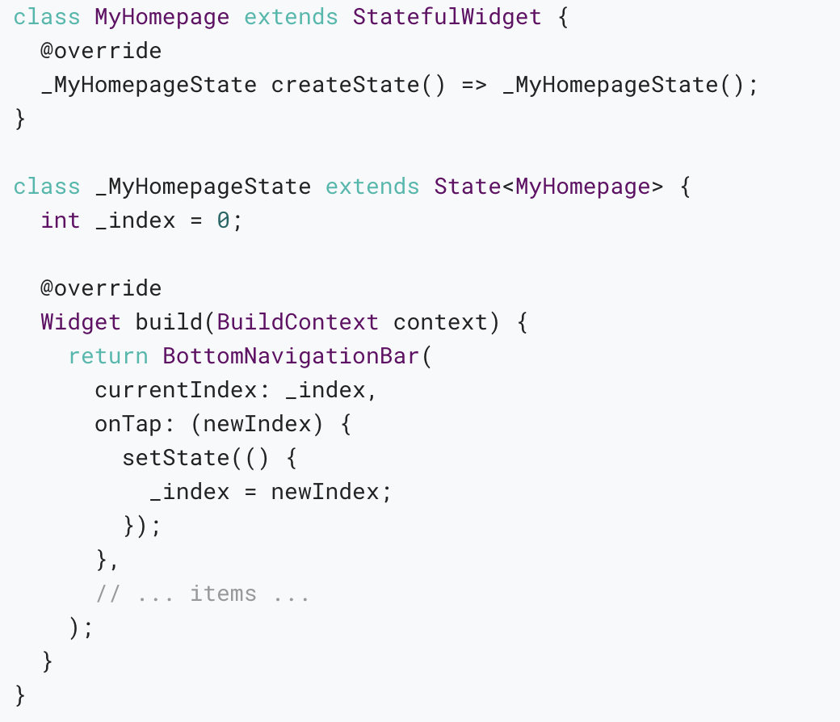
Below, you see how the currently selected item in a bottom navigation bar is held in the _index field of the _MyHomepageState class.
In this example, _index is ephemeral state.

Slide 10
App state
State that is not ephemeral, that you want to share across many parts of your app, and that you want to keep between user sessions, is what we call application state (sometimes also called shared state).

Slide 11
Examples of application state:
User preferences
Login info
Notifications in a social networking app
The shopping cart in an e-commerce app
Read/unread state of articles in a news app

Slide 12
There is no clear-cut rule
There is no clear-cut, universal rule to distinguish whether a particular variable is ephemeral or app state.
Sometimes, you’ll have to refactor one into another.

Slide 13
For that reason, take the following diagram with a large grain of salt:

Slide 14
The rule of thumb is: Do whatever is less awkward.
In summary, there are two conceptual types of state in any Flutter app.
Both types have their place in any Flutter app, and the split between the two depends on your own preference and the complexity of the app.

Slide 15
Simple app state management
Example
For illustration, consider the following simple app.
The app has two separate screens: a catalog, and a cart (represented by the MyCatalog, and MyCart widgets, respectively).

Slide 16
The catalog screen includes a custom app bar (MyAppBar) and a scrolling view of many list items (MyListItems).
Here’s the app visualized as a widget tree.

Slide 17
Lifting state up
In declarative frameworks like Flutter, if you want to change the UI, you have to rebuild it.
In Flutter, you construct a new widget every time its contents change.
This is what we mean when we say that widgets are immutable.
They don’t change—they get replaced.

Slide 18
Accessing the state
When a user clicks on one of the items in the catalog, it’s added to the cart.
But since the cart lives above MyListItem, how do we do that?
A simple option is to provide a callback that MyListItem can call when it is clicked.

Slide 19
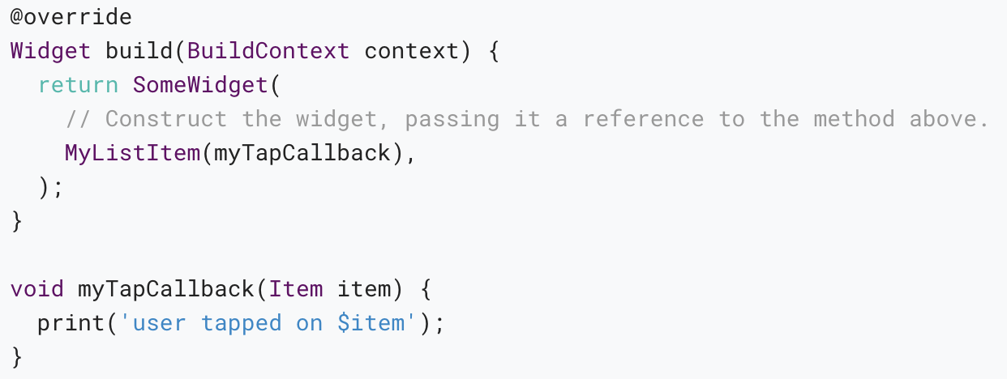
Inside MyCatalog you can define the following:

Slide 20
ChangeNotifier
ChangeNotifier is a simple class included in the Flutter SDK which provides change notification to its listeners.
In other words, if something is a ChangeNotifier, you can subscribe to its changes. (It is a form of Observable, for those familiar with the term.)
In provider, ChangeNotifier is one way to encapsulate your application state.

Slide 21
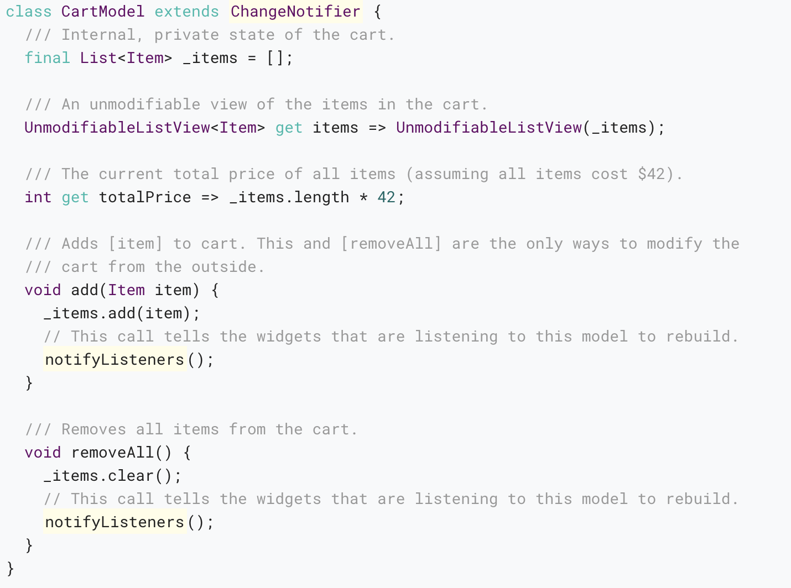
In our shopping app example, we want to manage the state of the cart in a ChangeNotifier.

Slide 22
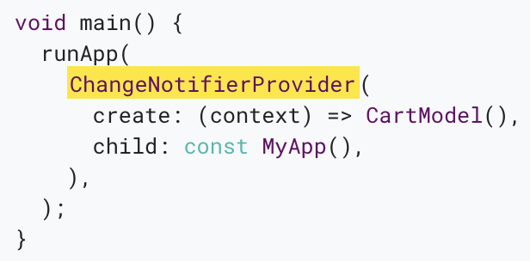
ChangeNotifierProvider
ChangeNotifierProvider is the widget that provides an instance of a ChangeNotifier to its descendants.
It comes from the provider package.

Slide 23
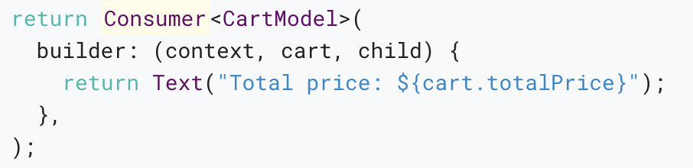
Consumer
Now that CartModel is provided to widgets in our app through the ChangeNotifierProvider declaration at the top, we can start using it.
This is done through the Consumer widget.

Slide 24
Putting it all together
You can check out the example covered in this article.
If you want something simpler, see what the simple Counter app looks like when built with provider.
See: provider_shoper (https://github.com/walkman617/samples/tree/master/provider_shopper )

Slide 25
Networking
Notes:
StatelessWidget is used for immutable elements that only rely on the object configuration information
StatefulWidget is used for elements that can dynamically change based on state-changes in the system
Everytime that state changes, setChange() is called by the object

Slide 26
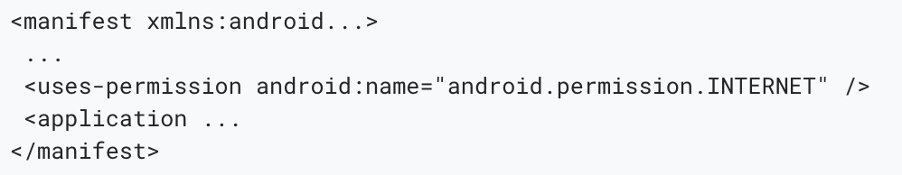
Cross-platform http networking
The http package provides the simplest way to issue http requests. This package is supported on Android, iOS, and the web.
Android apps must declare their use of the internet in the Android manifest (AndroidManifest.xml ):

Slide 27
networking cookbook
Delete data on the internet
Fetch data from the internet
Make authenticated requests
Parse JSON in the background
Send data to the internet
Update data over the internet
Work with WebSockets

Slide 28
JSON and serialization
Notes:
StatelessWidget is used for immutable elements that only rely on the object configuration information
StatefulWidget is used for elements that can dynamically change based on state-changes in the system
Everytime that state changes, setChange() is called by the object

Slide 29
Introduction
It is hard to think of a mobile app that doesn’t need to communicate with a web server or easily store structured data at some point.
When making network-connected apps, the chances are that it needs to consume some good old JSON, sooner or later.

Slide 30
Terminology
Encoding and serialization are the same thing—turning a data structure into a string.
Decoding and deserialization are the opposite process—turning a string into a data structure.
However, serialization also commonly refers to the entire process of translating data structures to and from a more easily readable format.

Slide 31
Which JSON serialization method is right for me?
Use manual serialization for smaller projects
Manual JSON decoding refers to using the built-in JSON decoder in dart:convert.
Use code generation for medium to large projects
JSON serialization with code generation means having an external library generate the encoding boilerplate for you.

Slide 32
Further references
The dart:convert and JsonCodec documentation
The json_serializable package on pub.dev
The json_serializable examples on GitHub

Slide 33
Firebase
Notes:
StatelessWidget is used for immutable elements that only rely on the object configuration information
StatefulWidget is used for elements that can dynamically change based on state-changes in the system
Everytime that state changes, setChange() is called by the object

Slide 34
Introduction
Firebase is a Backend-as-a-Service (BaaS) app development platform that provides hosted backend services such as a realtime database, cloud storage, authentication, crash reporting, machine learning, remote configuration, and hosting for your static files.

Slide 35
For more information, see:
The FlutterFire site
Getting started with Firebase and Flutter
Get to know Firebase for Flutter video workshop based on the codelab
Get to know Firebase for Flutter codelab
Multi Platform Firebase Flutter codelab
Use Firebase to host your Flutter app on the web

Slide 36
Thank you!
Wenxuan Shi
College of Software, Nankai University
Email: shiwx@nankai.edu.cn
Wechat: 13920561100

